Slide 1

SENSORED STREETLIGHT
BATCH-9
ARTIFICIAL INTELLIGENCE & DATA SCIENCE (I2)
1ST YEAR 2ND SEMESTER
M.SUCHITH REDDY(160122771112)
M.SRINU (160122771113)
M.RAM SAKETH (160122771114)
M.LOKESH GOUD (160122771115)
M.DANISH AHMED (160122771116)

Slide 2
ABSTRACT:
The main purpose of this project is to switch ON and OFF street lights
without manual operation.
By using this system energy consumption is reduced.
IR sensors are the main components of the project.
IR sensor is like our eye which detects the presence of an object.

Slide 3
INTRODUCTION:
In the present days Automated systems have less manual operations,
high flexibility, and accurate.
Especially in the field of electronics automated systems are giving good performance.
Our project is to control the switching of Street Lights automatically.
IR’s which detects the vehicle will ON the street light.

Slide 4
USES OF SENSORED STREETLIGHT TO SOCIETY:
One of the most significant use is cost savings.
Cities and Municipalities can reduce the amount of electricity they consume.
Safer traffic due to increased visibility of hazards.
During the night time when there is no light, the IR sends signal to turn on the street light.

Slide 5
LITERATURE REVIEW:
www.wikipedia.com
www.keil.com
www.maxim-ic.com
www.electronicsforu.com
www.allaboutcircuits.com
www.beyondlogic.org
www.atmel.com
Books Referred:
Raj Kamal –Microcontrollers Architecture, Programming, Interfacing, System Design.
Embedded C-Michael J Pont

Slide 6

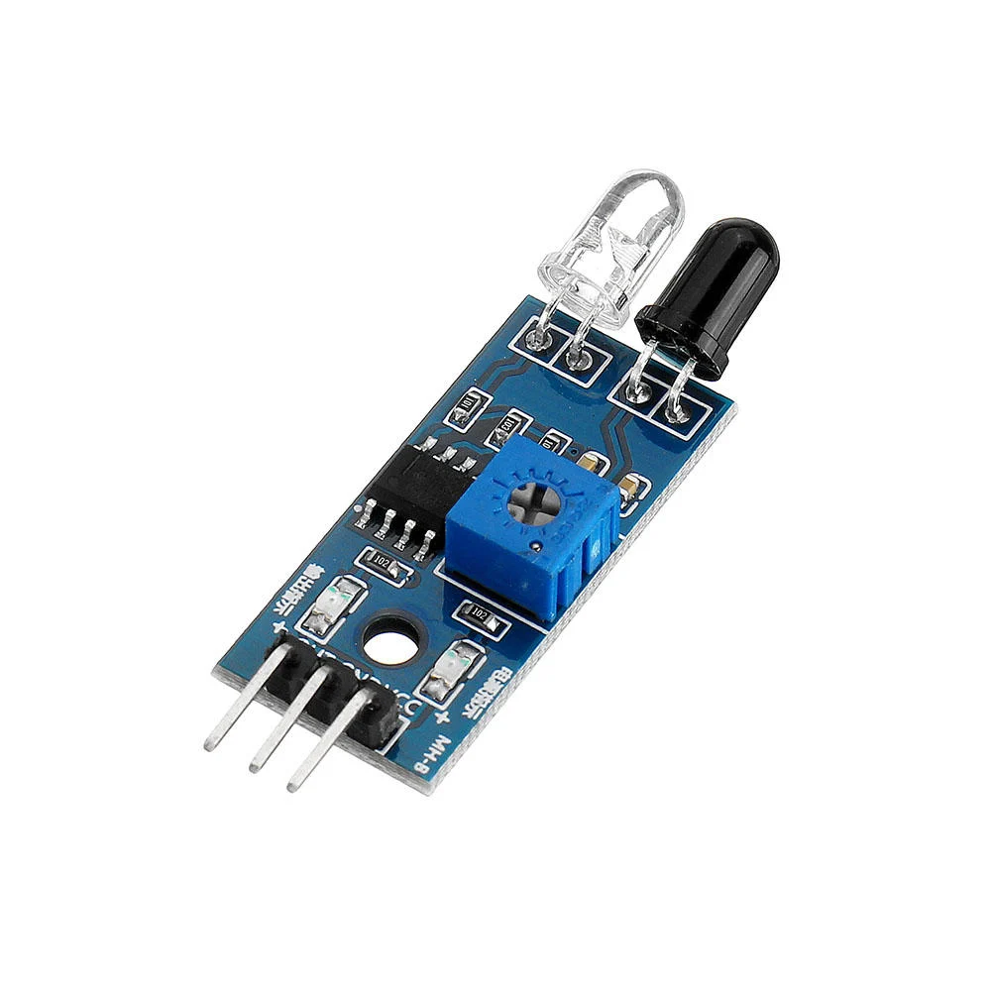
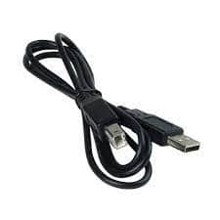
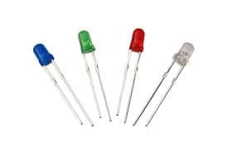
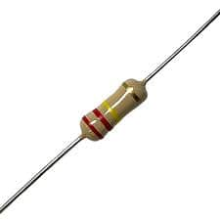
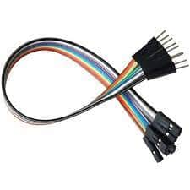
COMPONENTS USED:
Arduino
IR sensors
UNO cable
LEDS
Resistors
Jumper wires

Slide 7
USES AND FUNCTIONALITY OF THE COMPONENTS:
Arduino : able to read inputs - light on a sensor.
IR sensors : to detect movement as well as to measure the heat of an object.
Uno Cable : Transmits data or program at high speeds with error-free, high-performance transmission.
LED : is a widely used standard source of light in electrical equipment.
Resistors : reduce current flow, adjust signal levels, to divide voltages, bias active elements, and terminate transmission lines.
Jumper Wires : to connect two points to each other without soldering.

Slide 8
SPECIFICATIONS OF COMPONENTS:
Arduino UNO R3
IR Sensors
UNO cable (USB 3.O version)
LEDS(8 Multi-coloured)
Resistors(220 volts)
Jumper wires(32-35)

Slide 9
MATERIALS REQUIRED:
Card board
Straws
Charts(black and yellow)
A4 papers
Car Toy

Slide 10
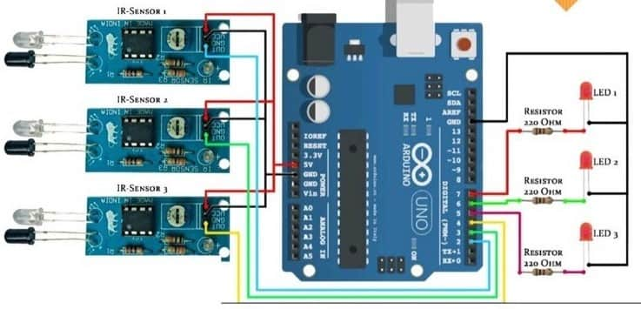
CIRCUIT DIAGRAM:

Slide 11
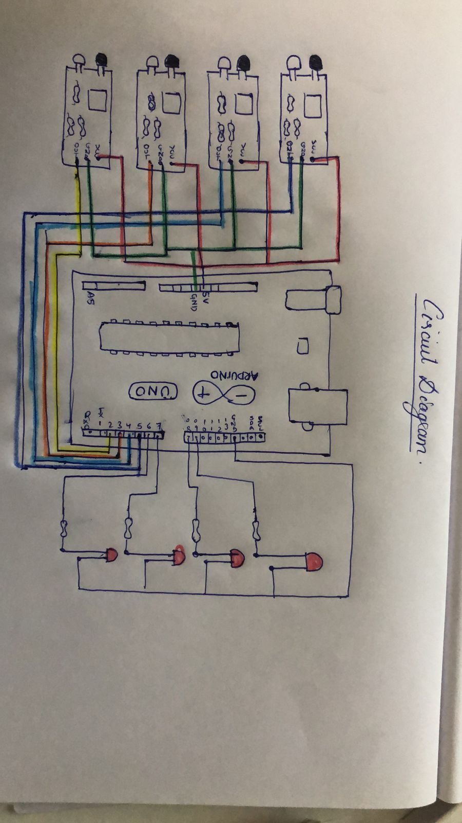
SKETCH:

Slide 12

CODE:

Slide 13

CODE:

Slide 14
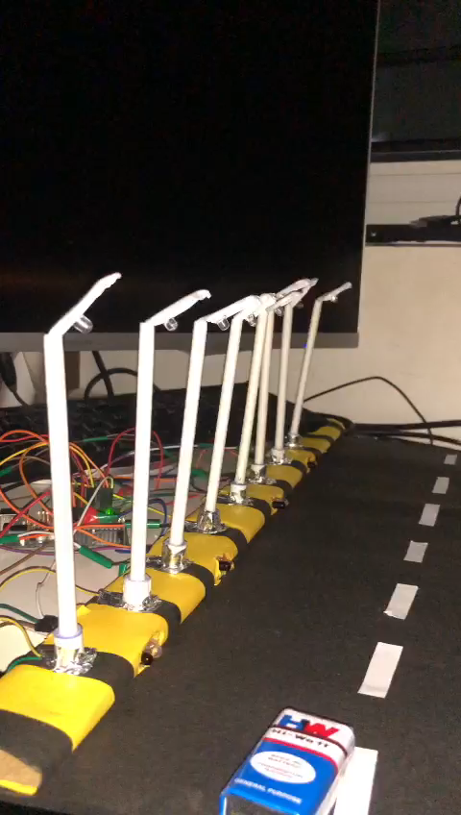
WORKING VIDEO:

Slide 15
CONCLUSION:
Can overcome the crisis of natural power production resources in forth coming days.
Can Reduce the wastage of electricity.
Ultimately can conserve some of the Natural Resources from completely getting varnished.
Leads to a Sustainable Development.
Provides Safety to vehicles and pedestrians.

Slide 16


